Slide 1


Slide 2

Protect your Data by Design:
Creating a Data Masking Strategy

Slide 3





About me
Chris Unwin
Solutions Architect
& Data Privacy and Protection Specialist
@PlantBasedSQL
DBAle on the Redgate Hub

Slide 4
Agenda
Why should we be masking data?
How much data are we handling?
Causes of data breaches
What does ‘Data Masking’ do?
Static vs Dynamic
Is it encryption?
How do we start masking?

Slide 5
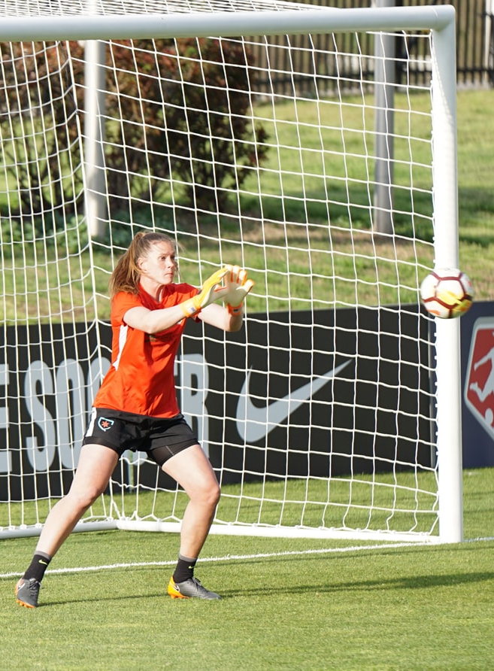
Goal
“To understand not only why it is important to protect data in non-Production environments, but how we can put controls in place to mitigate risk.”

Slide 6
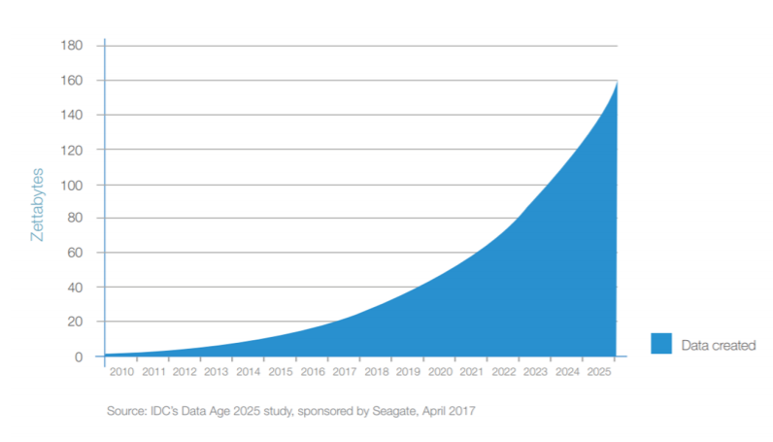
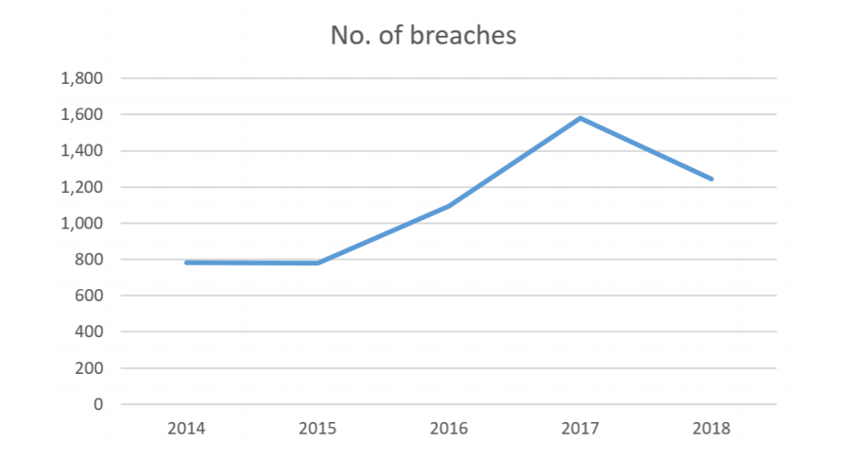

Why do we need to protect data? (1)
Worldwide data handling
Worldwide data breaches

Slide 7





Why do we need to protect data? (2)

Slide 8
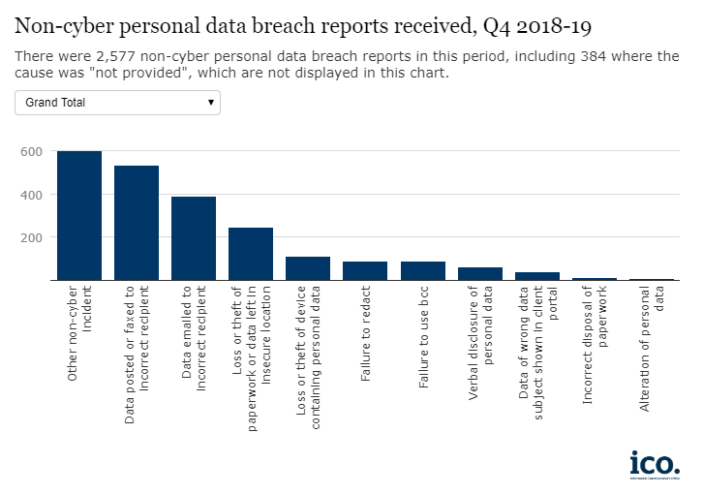
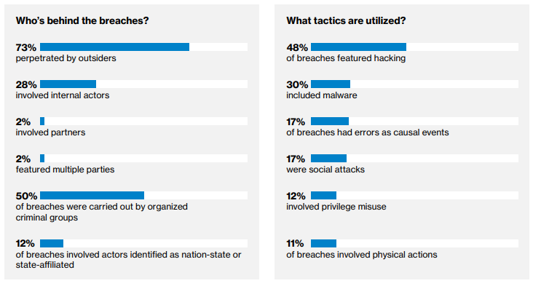
Where do data breaches come from?
ICO Data
Data Emailed to Incorrect Recipient: 392
Loss or Theft of device containing personal data: 112
Failure to Redact: 91
Source: Verizon Data Breach Investigations Report 2018: https://enterprise.verizon.com/resources/reports/DBIR_2018_Report.pdf

Slide 9
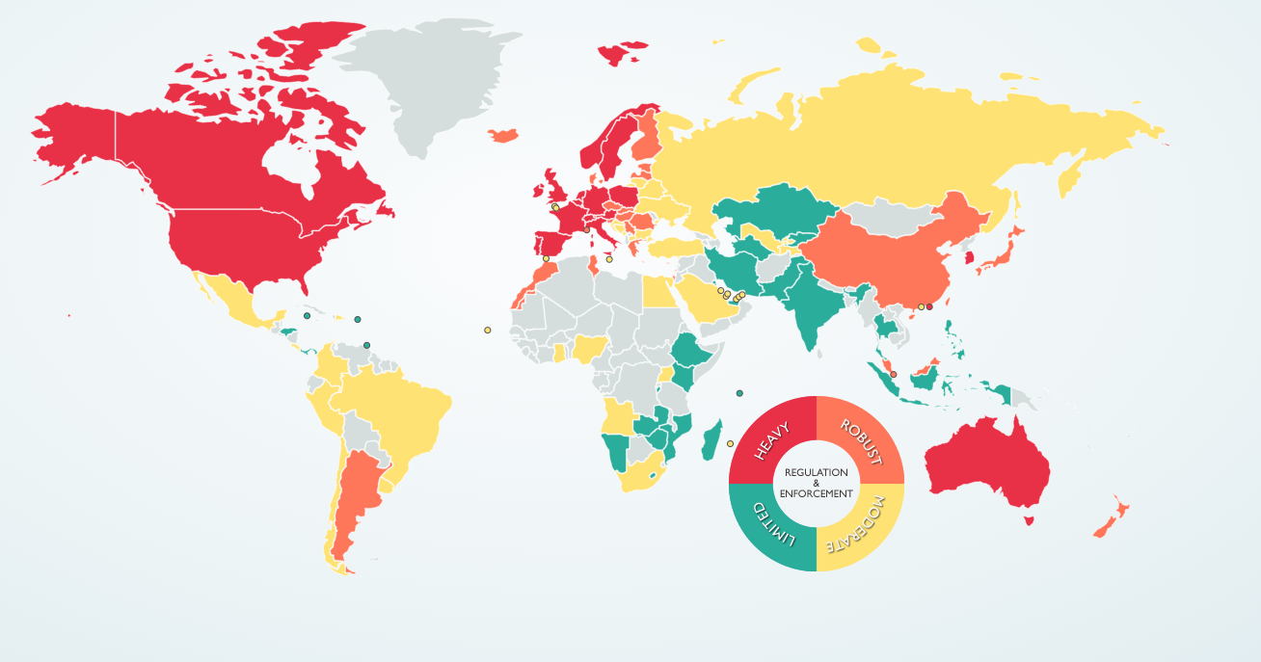





Why do we need to protect data? (3)
Source: DLA Piper - DATA PROTECTION LAWS OF THE WORLD

Slide 10

Regulations have teeth.
Maximum fines:
GDPR: €20m or 4% of total global turnover
LGPD (Brazil): BRL 50m or 2% of global sales revenue
CaCPA: ~$2,500 - $7,500 per capita, dependent on nature of data loss
Fines levied:
British Airways (GDPR): $230m
Anthem (HIPAA): $16m (+$115m Class Action Lawsuit)
Comscore (SOX): $5m + $700k

Slide 11

One thing is clear. We must set guardrails.
Notes:
Chris is primary on this section
https://unsplash.com/photos/RzzERMs0McA

Slide 12

WARNING! Word-heavy slide incoming WARNING!

Slide 13


1. Control Available Data
(b) collected for specified, explicit and legitimate purposes and not further processed in a manner that is incompatible with those purposes;
(e) kept in a form which permits identification of data subjects for no longer than is necessary for the purposes for which the personal data are processed;
2. Minimize PII Visibility
(c) adequate, relevant and limited to what is necessary in relation to the purposes for which they are processed (‘data minimisation’);
(f) processed in a manner that ensures appropriate security of the personal data, including protection against unauthorised or unlawful processing and against accidental loss, destruction or damage, using appropriate technical or organisational measures (‘integrity and confidentiality’).
https://gdpr-info.eu/

Slide 14

Control available data SETS
“We want to enable on-demand self service”
We do NOT want:
Copies of datasets everywhere
Insufficient storage
PII in datasets
Notes:
https://unsplash.com/photos/j6brni7fpvs

Slide 15
There are lots of ways to protect data
Keep the SQL Server patched & up to date
Control access
Limit numbers of Admins
Disable ‘sa’
Audit failed and successful logins regularly
Enable Encryption
Transparent Data Encryption (TDE)
Row Level Encryption
Always Encrypted
Data Masking

Slide 16
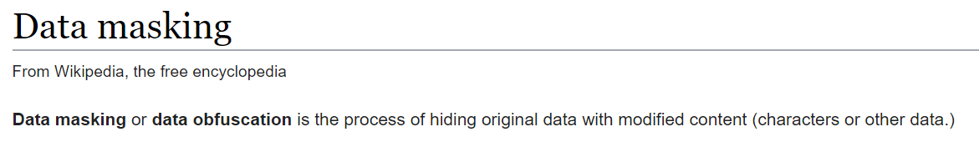
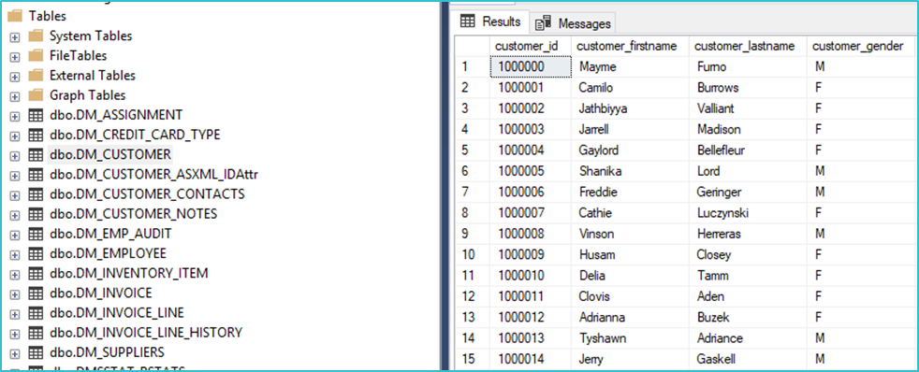
What IS Data Masking?

Slide 17

We have some things to think about first
?
?
Us
?
Data
Masking
What is so hard about Data Masking?

Slide 18
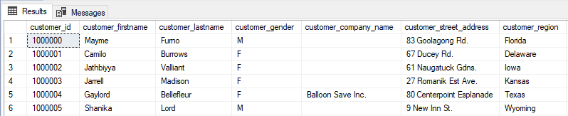
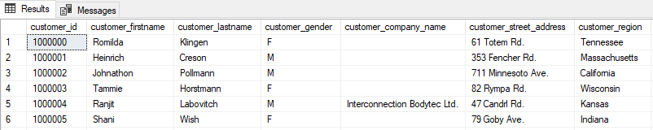
We require realism
It has to look like our data to be realistic for dev & test
We want to use our own sets of data to retain realism
We want to retain the usefulness, demographic and storage profile
NULLs have a part to play
How do we deal with free-text? Remove it all? Use excerpts from a book?

Slide 19

3 (well… 4) words on realism
Use your head (please)

Slide 20
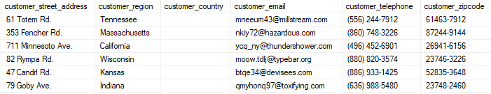
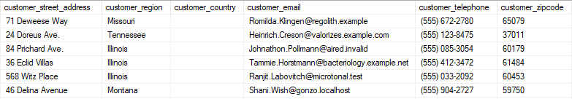
Data depends on data
Not every column exists in isolation from others
Some columns are concatenations of, or are correlated with others
We want data to still validate in test copies of our application like addresses
We want useful email addresses, but don’t want to send anything to a living individual

Slide 21
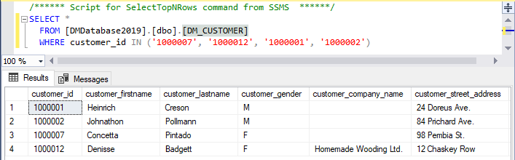
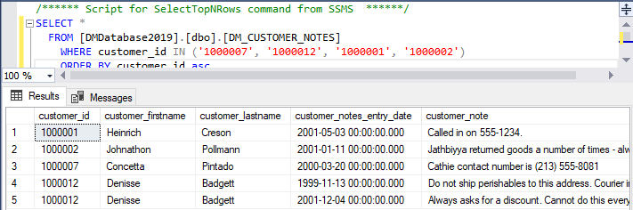
We’re not normal(ized) here!
Denormalization happens
Data should be consistent across tables where there is duplication
We don’t want to have to set up fresh masks for every column on every table
Once we have masked core tables we should be able to persist this elsewhere

Slide 22
It must be fast
There’s no point to any of this if it takes us 14 days to mask 10,000,000 rows!
We must optimize for speed – even if it means trading off resource power
We don’t want to slow down developers
It is a resource heavy operation and we would prefer everything ran concurrently where possible
Where is any of this happening anyway?
Notes:
https://unsplash.com/photos/Tof1HYnm0LY

Slide 23
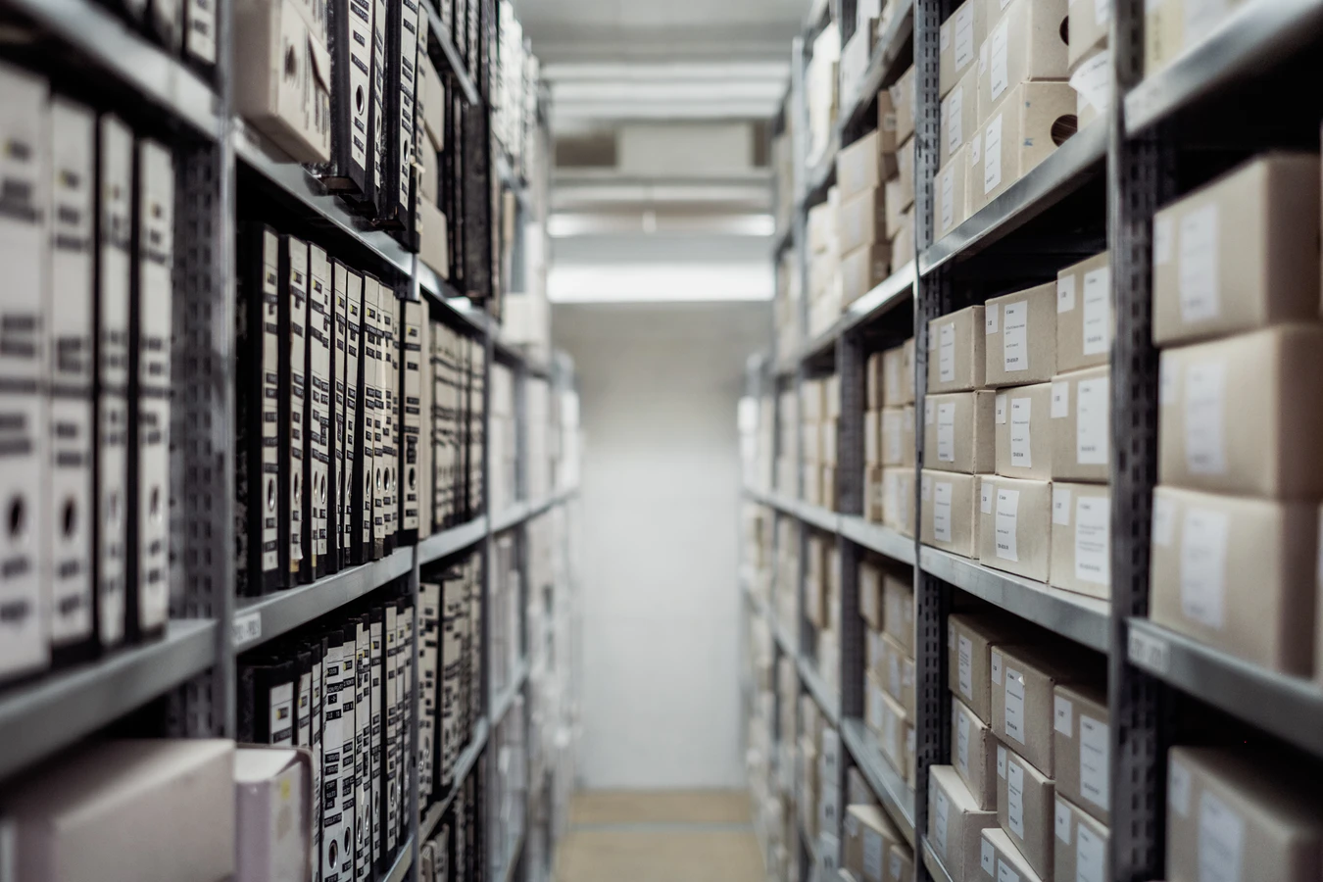
None of this matters, if we don’t know what we hold.

Slide 24

Understand your data first
Identify where your data is
Identify what your data is
Identify where the risk lies

Slide 25
Align people
on data risks

Slide 26
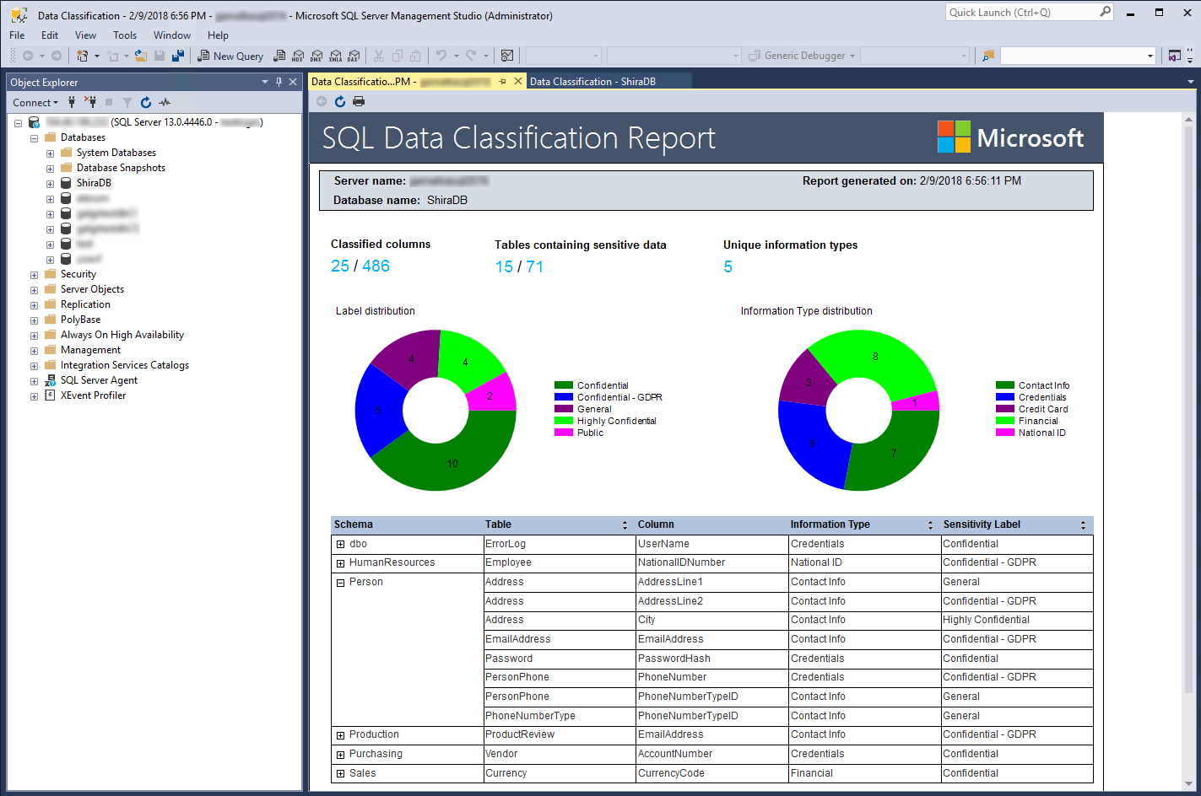
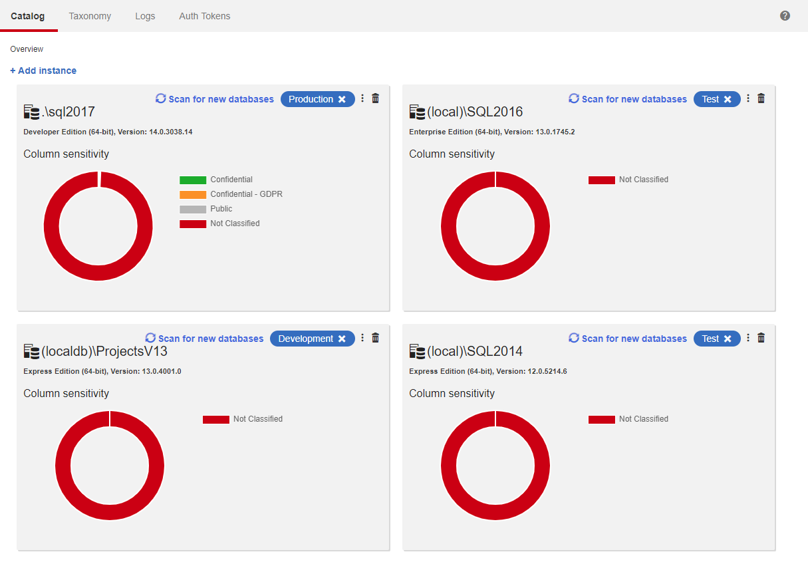
Catalog your data before anything else

Slide 27
Use this for informed decision making
We’re planning to migrate the server, is this a high risk project?
A developer has requested access to the database, can we authorise that?
If we experience a data breach, which systems are the most critical?
Who owns this data? Who’s in charge of keeping it up to date?

Slide 28

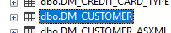
Once you know, you can protect
“Starting with YOU!”

Slide 29
Mask once and cascade
DM_Customer
Big Table
DM_Customer_Notes
DM_Customer_ASXML
DM_Customer_Contacts
Small Table

Slide 30
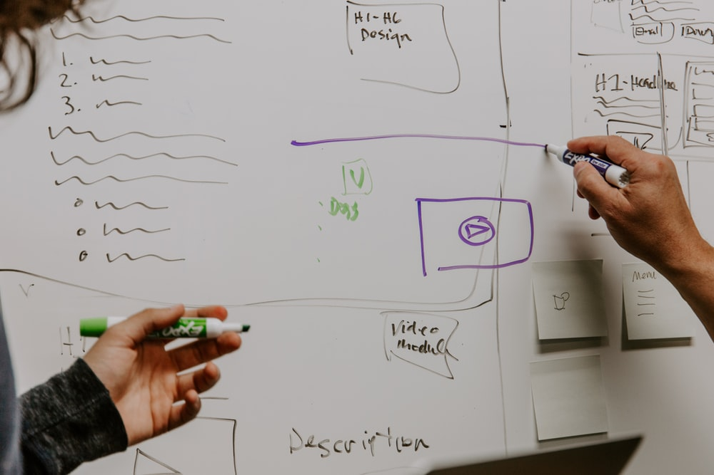
Classify, Mask & Clone
In Practice

Slide 31
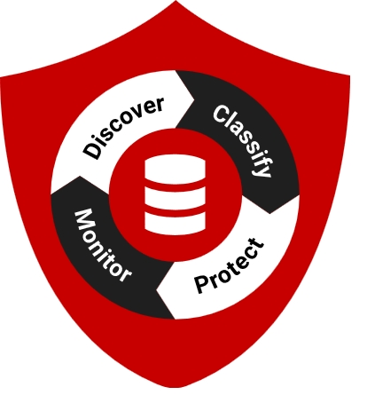
Essential Takeaways
Where is your data?
What exactly is your data?
Who is accessing your data, and for what purpose?
How can you demonstrate adequate protection?

Slide 32
Virtual booth
Get your virtual swag bag
Live chat to Redgaters and book 1-2-1 meetings
Discuss sessions with other attendees
Enter our competition to win an awesome prize
Sign up for Thursday’s pub quiz

Slide 33

DBAle pub quiz
Join us on Thursday April 2
1.30PM CDT / 7.30PM BST

Slide 34
Up next
Shortcuts from an impatient DBA
Andy Mallon
Microsoft Data Platform MVP and Founder of BostonSQL

